Slide 1

Estimating Covid-19 spread

Slide 2
Covid-19 Cluster Attributes
Different areas have been hit by Covid-19 at different rates. Are there localized attributes that signal an area is more susceptible to spreading Covid-19?
As governments are starting to re-open their economies. Is there a way to decide which types of business should be able to reopen?
Null hypothesis: The types of businesses within a zip code area have no effect on the level of covid-19 spread within that area. (For example, the null theorizes that a high prevalence of bars and eateries will not influence the covid-19 infection rates within that area)
*This project mandated the use of the foursquare places API which is why the effect variables are ‘venues’ rather than something which would likely be of more use*

Slide 3
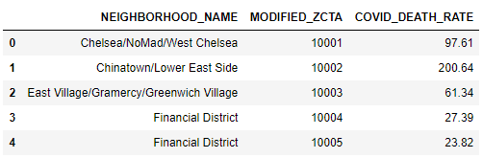
Data Acquisition
The following link was used to gather the different covid-19 death rates amongst zip-code areas within NYC:
https://github.com/nychealth/coronavirus-data/blob/master/data-by-modzcta.csv
Death rate was used because it is more indicative of the total number of people infected within a certain area. In other words we use death rate in place of infection rate even though the true target is infection rate.
The zip-codes were fed into Foursquare's explore endpoint API to append the prevalence of different types of businesses/venues located around that zip-code area.
In all there were 44 data points (zip-code areas) and approx. 250 different venue categories (bar, grocery store, gas station, etc.)

Slide 4
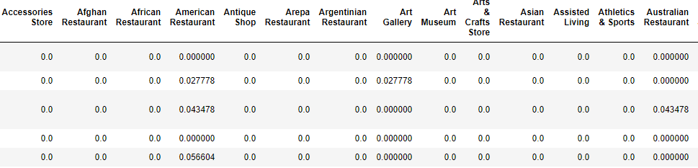
Multiple Linear Regression
Input Data excerpt:
The rows of the data add up to 1.00 with each value representing the proportion of a venue category that represent a zip-code area. (e.g. in the third row 0.027778 of venues in that area are American Restaurants)

Slide 5


Multiple Linear Regression cont.
The data was split and 75% of the venue categories data were fed to fit the model
The model used the remaining 25% of the data to made predictions for the target, Covid_Death_Rate.
The following are the results of the model:
A r^2 below 0 means that this model is worse at predicting the target variable than using the mean of the target variable as the predicted value. That is very bad.
One potential issue was there were only 33 data points used to fit the model and 249 fields. I reduced the number of fields by filtering for the fields which were most prevalent. This did not help the results:

Slide 6
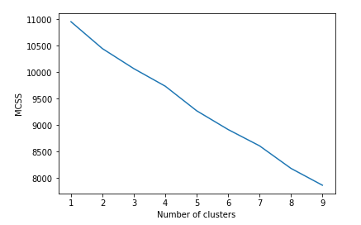
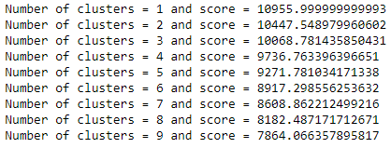
K-Means Analysis
Rather than trying to estimate the value of Covid_death_rate via MLR we will try to cluster the zip code areas based on their venue composition and see if there is a statistical difference of covid_death_rate among the different clusters.
K Means Results:
‘Score’ is a measure of within cluster sum of square (lower number is better)
There appears to be a slight kink at k=6 so we will use 6 clusters for the analysis

Slide 7
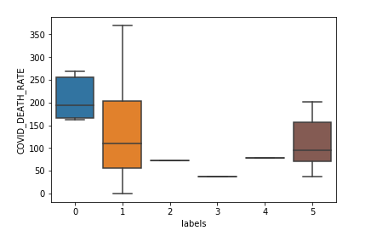
ANOVA
Once cluster labels were assigned, we took the mean covid_death_rates grouped by cluster values:
After running ANOVA, the p-value is 1.0
which means that there is no statistical
difference amongst the means of different
cluster groups.

Slide 8
Conclusion
Neither MLR nor K-means were able to provide any evidence that venue composition of different locations are responsible for different levels of covid-19 spread/infection rates.
We fail to reject the null-hypothesis.

